Slide 1
Airline on-time performance
Oleg Baydakov
December 10, 2017

Slide 2
Presentation content
Introduction – business problem understanding
Technical architecture design
Data acquisition and processing
Modeling testing and performance evaluation
Model deployment to production
Summary and Next steps

Slide 3
Introduction
The goal of the project is to execute data science exploration steps against flights data and create a regression model to predict what flight will be delayed
The data consists of flight arrival and departure details for all commercial flights within the USA, from October 1987 to April 2008.
For my analysis I will be using data for 2007-2008 years only. Data for 2007 will be splitted into training and validation sets, data for 2008 will serve as validation set to evaluate the model performance

Slide 4


Technical architecture design
YARN Manager
Topic #1
Raw
Topic #2
Topic #2
Decomposed
Source
Sink
Modelled
Hive SQL

Slide 5
Batch processing (Kafka step)
Start HDFS and YARN cluster
Start Apache Spark – master and 2 workers
Start Zookeper and Kafka cluser (3 nodes)
Create Kafka topics :
sh kafka-topics --create --zookeeper localhost:2181 --replication-factor 2 --partitions 2 --topic airports
sh kafka-topics --create --zookeeper localhost:2181 --replication-factor 2 --partitions 2 --topic planedate
sh kafka-topics --create --zookeeper localhost:2181 --replication-factor 2 --partitions 2 --topic carriers
* All scripts and technical details can be found in the attached Rmd file

Slide 6
Batch processing (Flume)
Create Flume configuration files for airports and planedate topcis to be ingested into HDFS
Configuration file example:
a1.sources.r1.zookeeperConnect=localhost:2181
a1.sources.r1.topic=airports
a1.sinks.k1.type = hdfs
a1.sinks.k1.hdfs.writeFormat=Text
a1.sinks.k1.hdfs.fileType=DataStream
a1.sinks.k1.hdfs.path=/data/raw/airports/
a1.sinks.k1.hdfs.filePrefix=airports
a1.sinks.k1.hdfs.rollCount=100000
a1.sinks.k1.hdfs.rollSize=0
a1.channels.c1.type = memory
a1.channels.c1.capacity = 10000
a1.channels.c1.transactionCapacity = 10000
a1.sources.r1.channels = c1 a1.sinks.k1.channel = c1
* All scripts and technical details can be found in the attached Rmd file

Slide 7
Batch processing (Kafka and Spark structured streaming integration)
Create Spark application
Read from Kafka topic (Scala code):
val df = spark .readStream .format("kafka") .option("kafka.bootstrap.servers", "localhost:9092") .option("subscribe", "carriers") .option("startingOffsets", "earliest") .option("failOnDataLoss", "false") .load()
Run required transofrmation agains topic:
val values = df.selectExpr("CAST(value AS STRING)").as[String]
Write topic to HDFSfrom Kafka topic (Scala code):
val query = values //.orderBy("window") .repartition(1) .writeStream .outputMode(OutputMode.Append()) .format("csv") .option("checkpointLocation", "hdfs://localhost:8020/tmp/checkpoints") .option("path", "hdfs://localhost:8020/data/raw/carriers") .start() .awaitTermination()
* Full Scala code can be found in the attached Scala file

Slide 8
Data transfer between HDFS zones
The most common method of cleaning and transferring data between HDFS zone is using Hive SQL on Tez.
Hive SQL example for airports table:
use decomposed;
drop table if exists airports;
CREATE EXTERNAL TABLE IF NOT EXISTS airports(iata STRING,airport STRING,city STRING,state STRING,country STRING,lat STRING,longt STRING, insert_time timestamp, uuid string) STORED AS AVRO LOCATION '/data/decomposed/airports';
use decomposed;
INSERT OVERWRITE TABLE airports SELECT * , CURRENT_TIMESTAMP AS insert_time, reflect("java.util.UUID", "randomUUID") as uuid FROM default.airports;
* All scripts and technical details can be found in the attached Rmd file

Slide 9
Regression model training and testing
Use Spark + R integration through sparklyr package
For model development 2 two dataset will be used:
2007 data splits into training and validation sets
2008 data for performance evaluation
For better performance all datasets will be cashed in Spark memory
Predict time gained or lost in flight as a function of distance, departure delay, and airline carrier
ml1 <- model_partition$train %>% ml_linear_regression(gain ~ distance + depdelay + uniquecarrier)
* All scripts and technical details can be found in the attached Rmd file

Slide 10
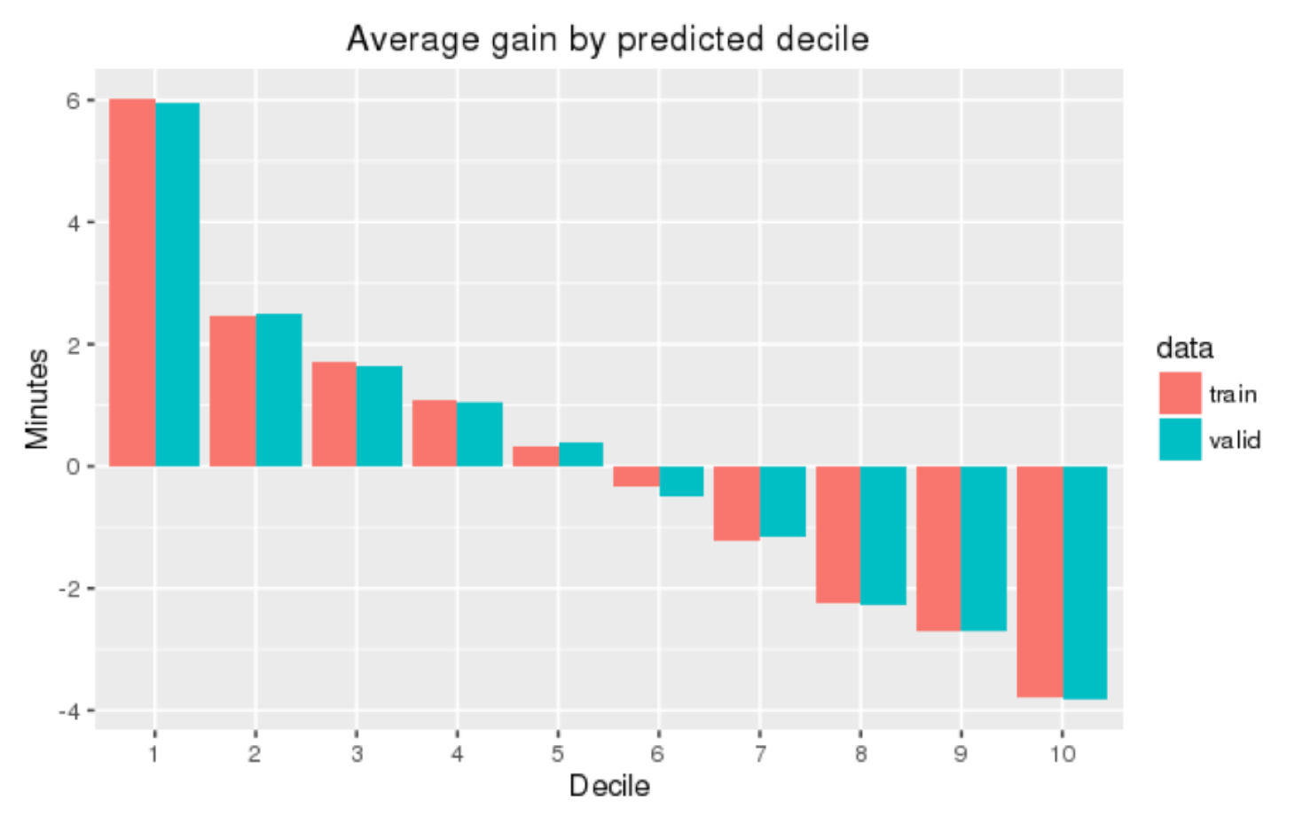
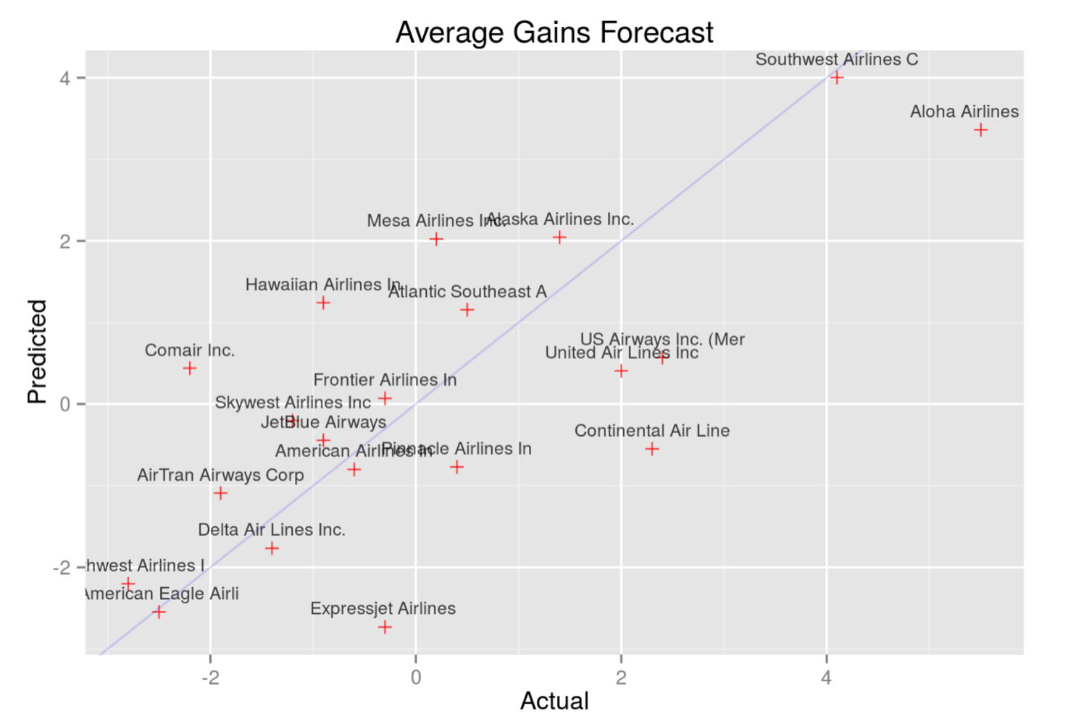
Model performance
* All scripts and technical details can be found in the attached Rmd file

Slide 11
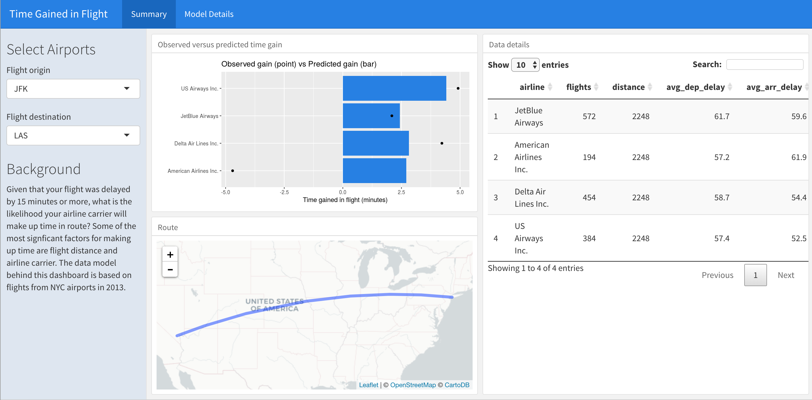
Model deployment to production
Create interactive dashboard as wrapper on the top of the model
* Click the link to open full function dashboard - Link

Slide 12
Summary
The objective of our analysis was to investigate whether certain carriers gained time after a departure delay. We built a simplistic linear model against a subset of the data and then validated the model against a hold out group. Finally, we assessed the model against an out of time sample within the the whole dataset and created the interective dashboard to deploy the model to production
We found that distance was the most significant predictor of gained time. The longer the flight, the more time gained. We also found that carrier effects were significant, but less so than distance. Certain carriers had significant positive effects, which is evidence that some carriers gain time after a departure delay.
This model included only a few predictors and used a simple form. More sophisticated models using more predictors (e.g. adjusting for weather) might lead to more conclusive results. However, given the weak fit of this model the level of opportunity is questionable.

Slide 13
Next Steps
Transform the dataset to graph format (Spark GraphX DataFrames) using departure and arrival airports as a grpah vertexes and flights as the edges with metadata attachments (weather, delays etc).
Run PageRank algorithm by counting the number and quality of flights to a airport to determine a rough estimate of how important the airport is
Take top 5 most important airports and calculate the most common destinations in the dataset from airport to airport to . We can do this by performing a grouping operator and adding the edge counts together. This will yield a new graph except each edge will now be the sum of all of the semantically same edges
Evaluate what impact the delays has on the departures from the same airport by calculating vertex “In Degrees”" and “Out Degrees”"

